Slide 1
Transfer API And RelativityOne

Slide 2
Scott Parillo

Slide 3
Overview (15 mins)
Getting Started (15 mins)
General Concepts and Configuration (20 mins)
Basic Demo (30 mins)
Advanced Demo (30 mins)
Wrap up (10 mins)

Slide 4
Overview

Slide 5
Addressed several RelativityOne needs
RDC/IAPI: how will these work w/o direct access?
Staging data for processing
Performance
Security
Filled API and tech gaps
Relativity never had a data transfer API
No high-performance or cloud storage support
Data transfer API’s can be complex
Why?

Slide 6
Transfer files from source to Relativity and vice-versa.
Supports on-prem/RelativityOne instances.
Thread safe and first-class async/await design.
Cancellation using CancellationToken.
Uniform object model – transfer client/job, configuration, and events.
Supports large file counts with minimal resources.
Supports HTTP, FileShare, Aspera, AzureBlob, and AzureFile transfer clients.
Relativity authentication.
Diagnostics with the Relativity Logging framework.
Core Features

Slide 7
Version | Description
Fall 2017 1.X | Initial API design RDC/IAPI integration Enhanced statistics and progress Azure blob/files transfer clients
Spring 2018 2.x | ROSE integration Large dataset support Stability and resiliency Bandwidth configuration
Summer 2018 3.x | RDC Export Health checks, diagnostics, and APM Long path support BCP/File share/credential data model
Fall 2018 4.x | Transfer CLI File migration and CSV support File storage API and targeted file shares Secure objects w/ DPAPI
Release
History

Slide 8
IBM technology
FASP® Protocol
TCP Channel (33001)
UDP Channel (33001-33050)
Advanced bandwidth features
Minimum and target settings
Adjustable at runtime
Security
AES-256 encryption
SHA-1 checksums
RelativityOne Aspera clusters
Per region
Enterprise Server v3.7.4
Supports shared and dedicated servers
Health checks, New Relic APM, and transfer diagnostics
Aspera and RelativityOne

Slide 9
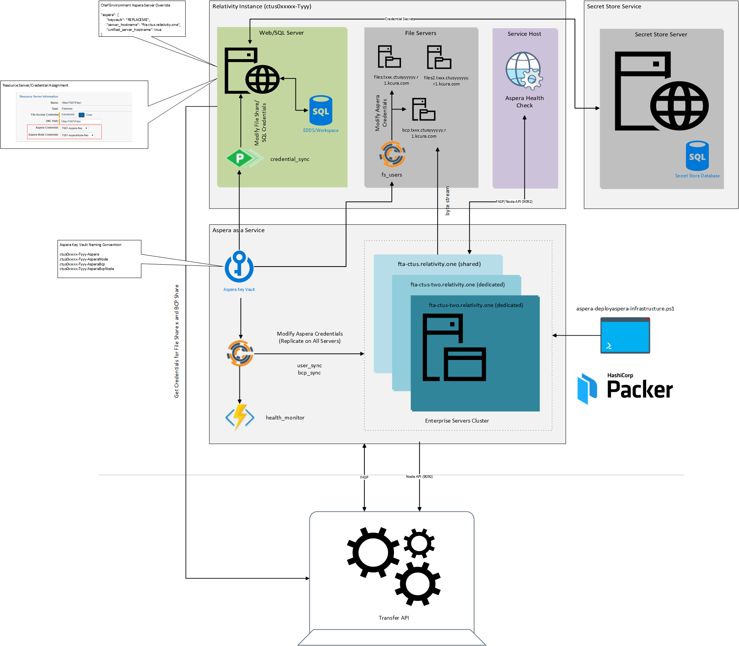
Data Transfer Architecture

Slide 10
Transferring files does not import documents.
RDC/Import API: use TAPI to transfer natives/load files to Relativity and eventually bulk insert file metadata.
Relativity One Staging Explorer: use TAPI to transfer natives to a staging location for eventual processing.
Transfer vs Import

Slide 11
Getting Started

Slide 12
https://github.com/relativitydev/transfer-api-samples
The “Sample solution and tutorial” contains all the instructions for today’s workshop.
Workbook
Document

Slide 13
Open C:\SourceCode\Relativity.Transfer.Sample\ Relativity.Transfer.Sample.sln solution.
Review the “Project Skeleton” instructions.
https://github.com/relativitydev/transfer-api-samples#project-skeleton
Pay close attention to the Binding redirects/Json.NET details.
Visual Studio Project

Slide 14
Follow the “Replace Main Method and Add Helpers” step.
https://github.com/relativitydev/transfer-api-samples#replace-main-method-and-add-helpers
Additional Sample Classes
Console2: adds headers for each API operation and changes the console text color.
AutoDeleteDirectory: creates a temp directory and uses Dispose to auto delete.
Additional Project Setup

Slide 15
General Concepts and Configuration

Slide 16
Navigate to the “General Concepts and Configuration” step.
https://github.com/relativitydev/transfer-api-samples#general-concepts-and-configuration
General Approach
Initialize the GlobalSettings object.
Create the ClientConfiguration object.
Create the ITransferLog object.
Create the IRelativityTransferHost object.
Create the ITransferClient object.
Overview

Slide 17
Open the Program class in Visual Studio.
Find the CreateRelativityTransferHost method.
Use the following parameters:
https://fest2018-current-sandbox.relativity.one/Relativity
Workspace: 1081808
Enter the supplied username/password.
Update URL and Credentials

Slide 18
Basic Demo

Slide 19
Navigate to the “Basic Demo” step.
https://github.com/relativitydev/transfer-api-samples#basic-demo
General Approach
Get the workspace file share object.
Create an upload transfer request for 1 test file.
Submit the transfer request, await completion, and display the results.
Create a download transfer request for 1 test file.
Submit the transfer request, await completion, and display the results.
Overview

Slide 20
Start with and follow the “Replace DemoBasicTransferAsync Method” step.
https://github.com/relativitydev/transfer-api-samples#replace-demobasictransferasync-method
Stop at the “Basic Start or Debug” step.
https://github.com/relativitydev/transfer-api-samples#basic-start-or-debug
Basic Demo Steps

Slide 21
Follow the “Basic Start or Debug” step.
https://github.com/relativitydev/transfer-api-samples#basic-start-or-debug
Execute the Demo

Slide 22
Advanced Demo

Slide 23
Navigate to the “Advanced Demo” step.
https://github.com/relativitydev/transfer-api-samples#advanced-demo
General Approach
Create an Aspera configuration object/TAPI client.
Specify a target file share.
Search for the local dataset.
Create an upload transfer job request, subscribe to transfer events, and create an upload transfer job.
Add the search result local paths to the job.
Await upload completion and display the results.
Create a download transfer job request, subscribe to transfer events, and create a download transfer job.
Add the search result remote paths to the job.
Change the data rate.
Await download completion and display the results.
Overview

Slide 24
Start with and follow the “Replace DemoAdvancedTransferAsync Method” step.
https://github.com/relativitydev/transfer-api-samples#replace-demoadvancedtransferasync-method
Stop at the “Advanced Start or Debug” step.
https://github.com/relativitydev/transfer-api-samples#advanced-start-or-debug
Advanced Demo Steps

Slide 25
Follow the “Advanced Start or Debug” step.
https://github.com/relativitydev/transfer-api-samples#advanced-start-or-debug
Execute the Demo

Slide 26
Relativity Community (community.relativity.com)
Developer Group
DevHelp Community (devhelp.relativity.com)
RelativityDev GitHub (relativitydev.github.io)
https://github.com/relativitydev/transfer-api-samples
https://github.com/relativitydev/transfer-cli

Slide 29
Questions?

